Slide 1
Tableau Products

Slide 2
Four Key Attributes to download Tableau products
Connectivity
What data sources do you need to access?
Distribution
Who do you want to see your dashboard and how will you share it with them?
Automation
Do you need your work to update automatically on a refresh schedule?
Security
Do you require an on-premise level of security or can your work be saved in the cloud?

Slide 3
Tableau Products
Let us broadly classify Tableau tools into the following categories:
Developer tools (Tableau Desktop and Tableau Public)
Sharing tools (Tableau Server, Tableau Online, Tableau Reader)
Developer tools will help you create a visualization and/or dashboards.
Sharing tools facilitate the following visualization and/or dashboards tasks:
Viewing
Sharing
Interacting
Exploring

Slide 4
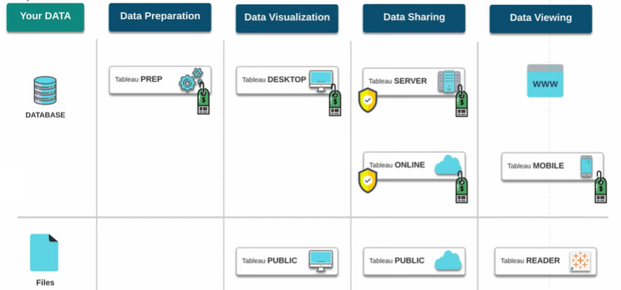

Slide 5
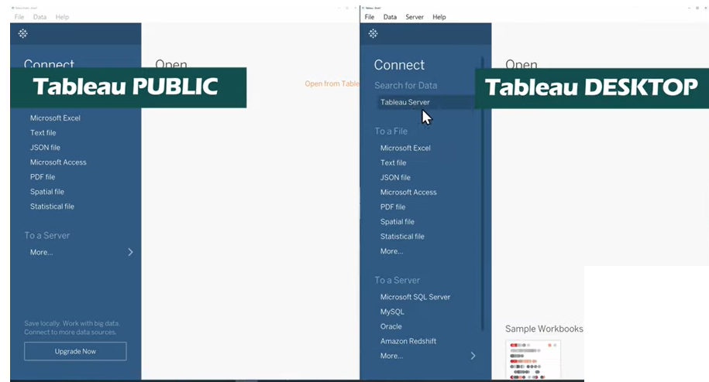

Slide 6
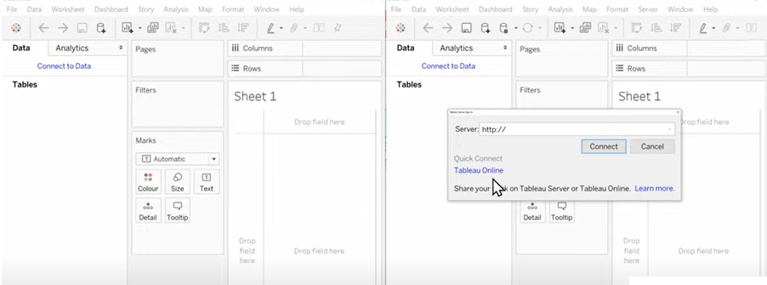

Slide 7
1. Tableau Desktop
Tableau Desktop is available in two versions:
Professional
Personal

Slide 8
1.1. Tableau Desktop: Personal
Tableau Desktop: Personal is the entry point for the paid development versions of the software.
It allows you to keep your workbooks private, but connection and distribution options are limited.
Connectivity - Excel, text files, Access, statistical files, shape files, spatial files, and Tableau files
Distribution - Offline or Tableau Public
Automation - Not available
Security - As good as your personal computer/server’s security
Best for - Those that only need to connect to flat data files; those that need the most cost-effective version that will keep their data private

Slide 9
1.2 Tableau Desktop: Professional
Tableau Desktop: Professional is similar to Tableau Desktop: Personal in that it is a development version of Tableau.
Both the Personal and Professional versions have all of the same development capabilities, but the Professional version provides full access to every data type and distribution channel currently available in the software.
Connectivity - All possible connections in Tableau
Distribution - Offline, Tableau Server, or Tableau Public (all possible distribution options in Tableau)
Automation - Not available
Security - As good as your personal computer/server’s security
Best for - Those that need to connect to data in databases; those that need the capability to publish to Tableau Server

Slide 10
2. Tableau Public
Tableau Public is another free download, but this product actually provides development capabilities.
The catch is that the workbooks have to be saved to Tableau’s public cloud, making this an unsuitable choice for proprietary business data.
Connectivity - Excel, text files
Distribution - Cloud (Public)
Automation - Not available
Security - Limited; your workbooks are potentially accessible by anyone on the web, but you are able to restrict the ability for someone to download your files
Best for - Journalists; sharing publicly available data (and Tableau know-how) with the world; practicing Tableau for free; trying the software

Slide 11
3. Tableau Server
Tableau Server provides a central repository for all of your Tableau workbooks that can be accessed by your business users via a web browser.
Tableau Server also has the advantage of data refresh capabilities as well as a way for your organization to keep its data and workbooks on premise in the case that your organization requires that level of security.
Tableau Server requires additional user licenses, even if you already have a Tableau Desktop license.
Connectivity - Workbooks that have been published to Tableau Server and that you have been granted access to
Distribution - On-premise or cloud
Automation - Available via data refresh schedules
Security - As good as your on-premise or server host’s security
Best for - Those that need to access/distribute workbooks in the cloud; those that want to automate workbook refreshes; those that want to edit workbooks in the cloud (limited capability); those that need to keep their data and workbooks on premise

Slide 12
4. Tableau Online
Tableau Online is similar to Tableau Server, but it is hosted via a third-party partner of Tableau.
This product still has the advantages of cloud distribution and automatic refreshes, but it is hosted off premise, which can result in security challenges for certain organizations.
Like Tableau Server, Tableau Online requires additional per-user licensing, even if those users already have access to Tableau Desktop.
Connectivity - Workbooks that have been published to Tableau Online and that you have been granted access to Distribution Cloud
Automation - Available via data refresh schedules
Security - As good as Tableau’s third-party host
Best for - Those that need to access/distribute workbooks in the cloud; those that want to automate workbook refreshes; those that want to edit workbooks in the cloud (limited capability); those that are having their data and workbooks hosted off premise

Slide 13
5. Tableau Reader
Tableau Reader is a free download that allows you to open “packaged workbooks,” which are Tableau workbooks that are saved in a special way by Tableau Desktop users so the data and visualizations are in the same file.
Tableau Reader allows you to open and interact with Tableau workbooks, but not develop them.
Development capabilities could be considered an obvious fifth key attribute, but as Tableau Reader is the only product listed that does not provide these capabilities, This product works much like a PDF viewer, where a developer of a document saves it in a certain way so that it can be opened by a PDF reader.
Connectivity - .twbx files only (packaged workbooks)
Distribution - Offline
Automation - Not available
Security - As good as your personal computer/server’s security
Best for - People that need an affordable way to view and interact with colleagues’ Tableau workbooks

